Slide 1


Noida Institute of Engineering and Technology, Greater Noida
Designing Organization for Digital Success
Unit: 4
Digital Marketing (AOE0667)
Shruti Mittal
Assistant Professor MBA
Course Details (B Tech CYS & AI 6th Sem )

Slide 2

Index/ Content
S. No. | Index
1. | Name of Subject with code, Course and Subject Teacher
2. | Brief Introduction of Faculty member with Photograph
3. | Evaluation Scheme
4. | Syllabus
5. | Branch wise Application
6. | Course Objective(s)
7. | Course Outcome(s)
8. | Program Outcomes (POs)
9. | COs and POs Mapping

Slide 3
Index/ Content
S. No. | Index
10. | Program Specific Outcomes (PSOs)
11. | Cos and PSOs Mapping
12. | Program Educational Objectives (PEOs)
13. | Result Analysis
14. | End Semester Question paper Templates
15. | Prequisite/Recap
16. | Brief Indtroduction about the Subject with Videos
17. | Unit Contents
18. | Unit Objectives
19. | Topic Objectives/ Topic Outcome

Slide 4
Index/ Content
S. No. | Index
20. | Lecture related to topic
21. | Daily Quiz
22. | Weekly Assignment
23. | Topic Links
24. | MCQs
25. | Glossary Questions
26. | Old question papers
27. | Expected Questions
28. | Recap of unit

Slide 5
Brief Introduction of the Faculty Member

Slide 6
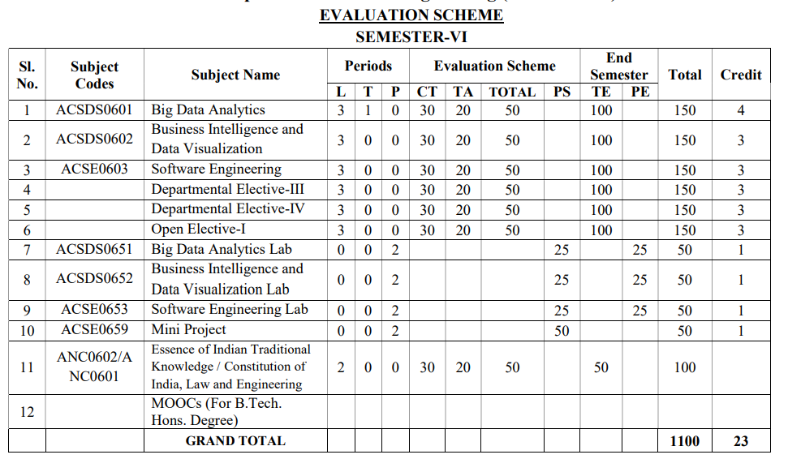
Evaluation Scheme

Slide 7
Subject Syllabus
DIGITAL MARKETING
DETAILED SYLLABUS |  | 3-1-0
Unit | Topic | Proposed Lecture
I | Introduction to Digital Marketing: The new digital world - trends that are driving shifts from traditional marketing practices to digital marketing practices, the modern digital consumer and new consumer’s digital journey. Marketing strategies for the digital world-latest practices. | 08
II | Social Media Marketing -Introduction to Blogging, Create a blog post for your project. Include headline, imagery, links and post, Content Planning and writing. Introduction to Face book, Twitter, Google +, LinkedIn, YouTube, Instagram and Pinterest; their channel advertising and campaigns. | 08
III | Acquiring & Engaging Users through Digital Channels: Understanding the relationship between content and branding and its impact on sales, search engine marketing, mobile marketing, video marketing, and social-media marketing. Marketing gamification, Online campaign management; using marketing analytic tools to segment, target and position; overview of search engine optimization (SEO). | 08
IV | Designing Organization for Digital Success: Digital transformation, digital leadership principles, online P.R. and reputation management. ROI of digital strategies, how digital marketing is adding value to business, and evaluating cost effectiveness of digital strategies. | 08
V | Digital Innovation and Trends: The contemporary digital revolution, digital transformation framework; security and privatization issues with digital marketing Understanding trends in digital marketing – Indian and global context, online communities and co-creation. | 08

Slide 8
Branch Wise Application
With the advent of new technologies, the field of Marketing has seen a paradigm shift over the years.
Though it is still in use, businesses across the world have switched from traditional modes of marketing to digital marketing.
This, in turn, has created many new opportunities for companies to expand their business and has created tremendous employment opportunities across sectors.
From Content Curation and Management to Social Media Marketing and Brand Management, a career in Digital Marketing can take you in several directions.
Top Job Profiles: Digital Marketing Manager, Social Media Manager, Content Writer, Influencers.

Slide 9
Course Objective
1 | Provide understanding of digital and social media marketing practices.
2 | Provide understanding of the concept of social media platforms
3 | Impart learning on various digital channels and how to acquire and engage consumers online.
4 | Provide insights on building organizational competency by way of digital marketing practices and cost considerations.
5 | Develop understanding of the latest digital practices for marketing and promotion.

Slide 10
Course Outcome
CO1-Develop an understanding of digital and social media Marketing practices. | Knowledge (K2), Remembering (K1)
CO2- Develop Understanding of Social Media Platforms. | Comprehending (K 3)
CO3- Acquire the skill to acquire & engage customer online. | Knowledge (K2), Analyzing (K4)
CO4- Develop understanding of building organizational competency by way of Digital Marketing practices & cost considerations. | Knowledge (K2), Applying (K5)
CO5-Understanding latest Digital Marketing Practices for promotion. | Knowledge (K2), Applying (K4)

Slide 11
Program Outcomes
1. PO1 Engineering knowledge - Apply the knowledge of mathematics, science, engineering fundamentals, and an engineering specialization to the solution of complex engineering problems
2. PO2 Problem analysis - Identify, formulate, review research literature, and analyze complex engineering problems reaching substantiated conclusions using first principles of mathematics, natural sciences, and engineering sciences
3. PO3 Design/development of solutions - Design solutions for complex engineering problems and design system components or processes that meet the specified needs with appropriate consideration for the public health and safety, and the cultural, societal, and environmental considerations
4. PO4 Conduct investigations of complex problems - Use research-based knowledge and research methods including design of experiments, analysis and interpretation of data, and synthesis of the information to provide valid conclusions

Slide 12
Program Outcomes
5. PO5 Modern tool usage - Create, select, and apply appropriate techniques, resources, and modern engineering & IT tools including prediction and modeling to complex engineering activities with an understanding of the limitations.
6. PO6 The engineer and society - Apply reasoning informed by the contextual knowledge to assess societal, health, safety, legal and cultural issues and the consequent responsibilities relevant to the professional engineering practice.
7. PO7 Environment and sustainability - Understand the impact of professional engineering solutions in societal and environmental contexts, and demonstrate the knowledge of, and need for sustainable development.
8. PO8 Ethics - Apply ethical principles and commit to professional ethics and responsibilities and norms of the engineering practice.
9. PO9 Individual and team work - Function effectively as an individual, and as a member or leader in diverse teams, and in multidisciplinary settings.

Slide 13
Program Outcomes
10. PO10 Communication - Communicate effectively on complex engineering activities with the engineering community and with society at large, such as, being able to comprehend and write effective reports and design documentation, make effective presentations, and give and receive clear instructions.
11. PO11 Project management and finance - Demonstrate knowledge and understanding of the engineering and management principles and apply these to one’s own work, as a member and leader in a team, to manage projects and in multidisciplinary environments.
12. PO12 Life-long learning - Recognize the need for, and have the preparation and ability to engage in independent and life-long learning in the broadest context of technological change.

Slide 14
CO-PO Mapping
Digital Marketing (AOE0667 )
CO/PO | PO1 | PO2 | PO3 | PO4 | PO5 | PO6 | PO7 | PO8 | PO9 | PO10 | PO11 | PO12
CO1 | 1 | 1 | - | - | - | 1 | 2 | - | - | 1 | - | -
CO2 | - | 2 | - | - | 2 | - | 2 | - | - | - | 1 | -
CO3 | 2 | 2 | - | - | 3 | - | - | 2 | - | - | - | -
CO4 | 3 | - | - | 1 | - | 2 | - | - | 1 | - | - | 1
CO5 | 2 | - | 1 | - | - | - | 3 | - | - | - | - | -

Slide 15
Program Specific Outcomes
Our graduates will be able to
PSO1: Apply suitable techniques, modern tools to solve complex engineering problems in the field of computer science.
PSO2: Design and optimize, ethical and innovative solutions for the betterment of the society.
PSO3: Work as an individual or lead in a team with good communication and engage in life-long learning.

Slide 16
Program Educational Objectives
PEO1: Conceptual Knowledge to adapt in rapidly changing environment and learn new skills and demonstrate application of management principles in professional work setting.
PEO2: Apply appropriate tools for decision making for solving complex managerial problems in local or global context.
PEO3: Exhibit Integrity, social responsibility and teamwork.
PEO4: Exhibit ethics, communication skills, leadership qualities and entrepreneurial mindset.

Slide 17
Result Analysis
 |  |  |  |  |  |  |  |  | No. of students in Marks Range
Subject Name | Section | Faculty Name | Total Students | Pass Students | % Section wise Result | Overall % Result of Subject | Highest Marks | Average Marks | 40 - 50 | 51-60 | 61-70 | 71 - 80 | >81
Digital Marketing | -

Slide 18
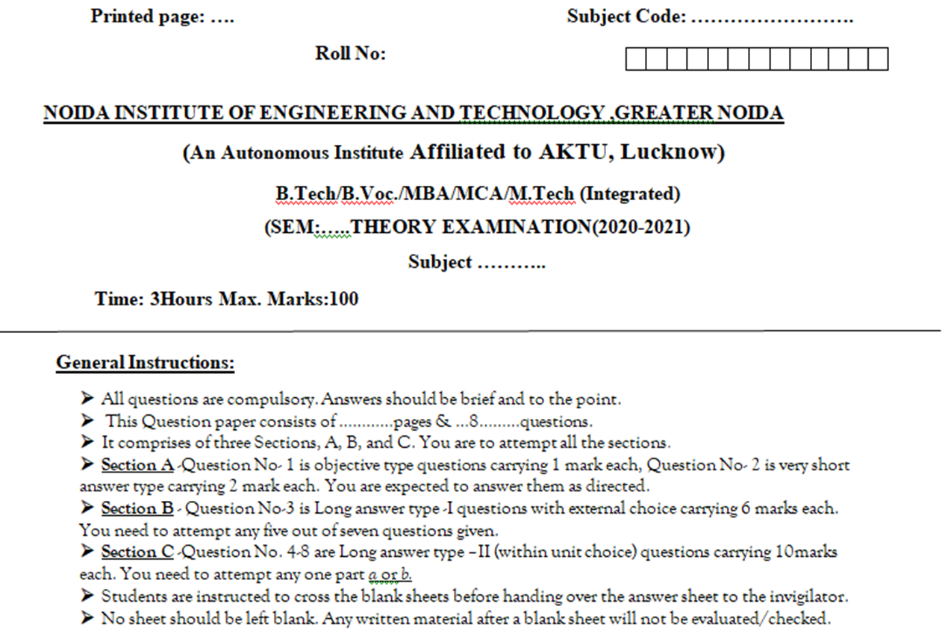
End Semester Question Paper Template

Slide 19
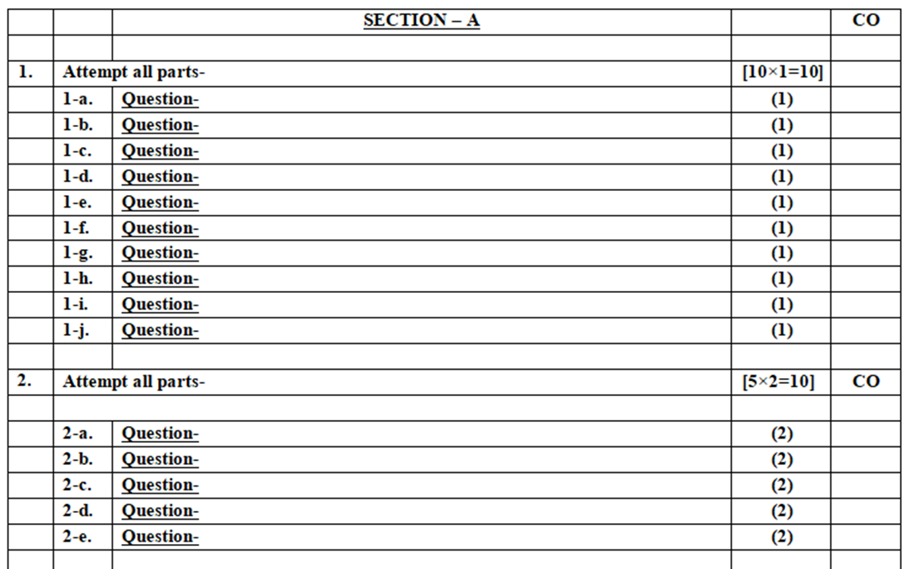
End Semester Question Paper Template

Slide 20
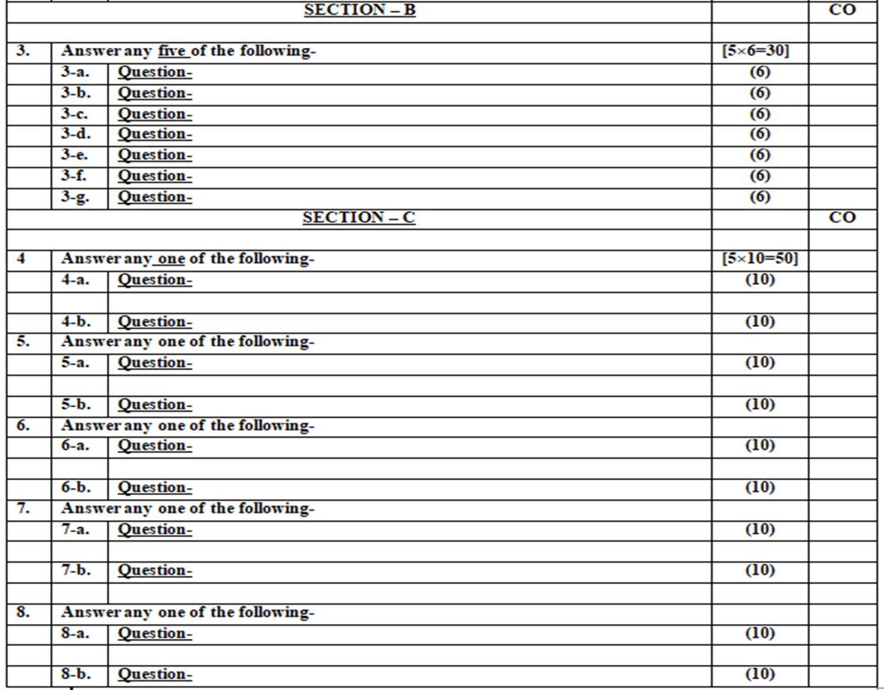
End Semester Question Paper Template

Slide 21
Prerequisite
Student should have general understanding of:
1. Digital business
2. Digital technologies
3. Digitalization

Slide 22
Brief Introduction about the Subject
The course is designed to make learner conversant with Digital Marketing and proficient in Social Media tools and techniques starting from the fundamentals of digital marketing.
Social media websites and applications allow users to create and exchange user-generated content where people talk, share information, participate and network through technologies such as blogs and social networking sites.
Within the last decade, social media has become one of the most powerful sources for news updates, online collaboration, networking, viral marketing and entertainment.
https://www.youtube.com/watch?v=Xuq6_udbeH0&list=PLi3oNa09iwJRByiNwEJNaZ3XVKcveovzk
https://www.youtube.com/watch?v=X-pCbWwu50k

Slide 23
Unit Objectives
To make the students understand the Digital transformation and digital Leadership.
To explain the Online PR and reputation management .
To understand how to calculate ROI of digital strategies.
To develop a basic understanding on Website development.

Slide 24
Topic Objective/ Topic Outcome
Name of Topic | Objective of Topic | Mapping with CO
Digital Organization | To understand the digital Organization | CO4
Digital Transformation | To understand the Digital transformation | CO4

Slide 25
Digital Organization
The proliferation and converge of digital technologies like SMACIT (Social, Mobile, Analytics, Cloud and Internet of things) has created significant threats and opportunities to established companies.
Business leaders must rethink their business strategies and develop what we refer as digital strategy.

Slide 26
Digital Organization
There are four keys to successfully defining and executing digital strategy-
Building operational excellence
Creating a powerful digital services backbone to facilitate rapid innovation and responsiveness
Ensuring ongoing digital redesign

Slide 27
Features of Digital Organization
Digital organizations are collaborative and non-hierarchical.
They are populated by Millennials and digital agents who intelligently work side by side.
Digital organizations need digitally aware and adapt leaders who can set the digital agenda and create the context for the digitization of every relevant aspect of their organizations.
Digitization is occurring at an accelerating pace; successful digital leaders need to synchronize their organizations to digital clock speed.

Slide 28
Digital Marketing is adding value to the business
Improved Customer Service
Get Valuable Data and Analytics
Higher Conversion Rates and Increased Revenue
Preparedness for the Internet of Things
Global reach
Lower cost
Traceable, measurable results
Personalization
Improved conversion rates

Slide 29
Digital Transformation
Digital transformation is the process of using digital technologies to create new — or modify existing — business processes, culture, and customer experiences to meet changing business and market requirements. This reimagining of business in the digital age is digital transformation.

Slide 30
Digital Transformation
In a narrower sense, “digital transformation” may refer to the concept of “going paperless” or reaching a “digital business maturity” affecting both individual businesses and whole segments of society, such as government, mass communications, art, medicine, and science.
The debate surrounding digitalization has therefore gained increased practical importance for politics, business and social issues, and is linked to political work issues for community development, new changes in the practical business .

Slide 31
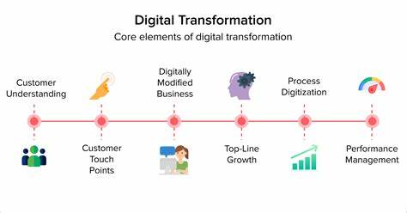
Elements of Digital Transformation

Slide 32
Cloud Computing
Cloud computing means storing and accessing the data and programs on remote servers that are hosted on the internet instead of the computer’s hard drive or local server.
Cloud computing is also referred to as Internet-based computing some of these digital solutions enhance the capabilities of traditional software products (e.g. Microsoft Office compared to Office 365) while others are entirely cloud-based (e.g. Google Docs).

Slide 33
Internet of Things
The Internet of Things is the concept of connecting any device (so long as it has an on/off switch) to the Internet and to other connected devices.
The IoT is a giant network of connected things and people – all of which collect and share data about the way they are used and about the environment around them.

Slide 34
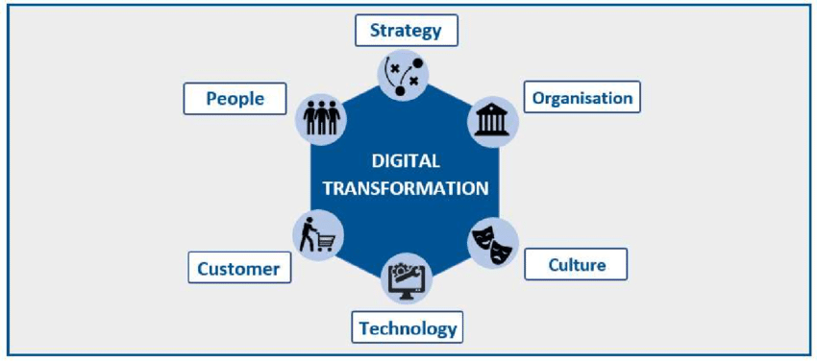
Digital Transformation

Slide 35
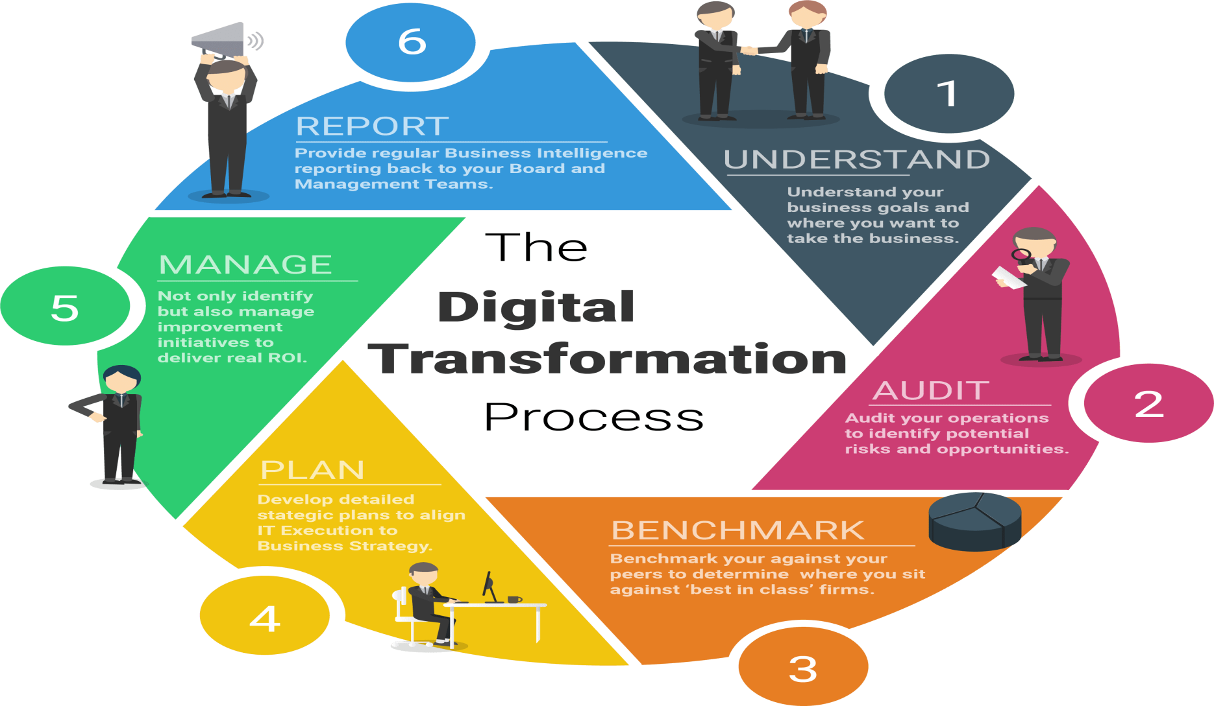
Process of Digital Transformation

Slide 36
Recap
In this topic, We learned about Digital Transformation.
We also learned about its features & process.

Slide 37
Daily Quiz
_______ is the on-demand delivery of IT resources over the Internet with pay-as-you-go pricing.
IoT stands for ______.
_______ is the process of using digital technologies to create new — or modify existing — business processes.
A ______ organisation is one that seeks to improve performance by new and emerging electronic and "information technology" tools.

Slide 38
Noida Institute of Engineering and Technology, Greater Noida
Digital Leadership
Topic 2
Digital Marketing (AOE0667)

Slide 39
Prerequisite
Basic knowledge of Digital Marketing.

Slide 40
Topic Objective & Topic Outcome
Name of Topic | Objective of Topic | Mapping with CO
Digital Leadership | To study the meaning of Digital Leadership & progressive Leadership | CO4

Slide 41
Digital Leadership
Digital leadership describes the strategic use of a company’s digital assets to achieve its business goals. A digital leader is an individual that sets the use of those assets in motion and tracks the success of their application.
An effective digital leader will be aware of the business goals and knows how their job responsibilities support them.
At an organizational level the digital leader could for example be a company that has successfully taken advantage of its digital assets to gain and also maintain a competitive edge.

Slide 42
Digital Leadership
These digital leaders will explore how technology can be used to help their business become much more responsive to the needs of their customers and the ever-changing business requirements.
They place high value on their communication, creativity and willingness to explore the ways that new emerging technology and digital information can be used to help business projects.

Slide 43
Benefits of Digital Leadership
It builds a digital culture – different departments within a business will require different digital tools to improve their work. Having an effective digital leader helps to make this happen within your organization giving them the right tools available to them.

Slide 44
Benefits of Digital Leadership
Makes employees more productive – the tools provided to your organization are designed to increase productivity levels, however, without a digital leadership to drive this, employees could struggle to implement and get the most out of these tools. Digital leadership ensures that your workforce can concentrate on using it straight away.
Improves customer satisfaction – a satisfied customer will have no reason to leave your business for a competitor, but a dissatisfied one will have several reasons. Digital leadership can help this by improving and introducing convenience, speed and customer support, for example. This in turn makes a customer increasingly satisfied with your product or service

Slide 45
Benefits of Digital Leadership
Increases revenue – it’s simple, serving more customers in less time is an effective recipe for making more money within your business. There are many ways that digital leadership can help increase revenue.

Slide 46
Progressive Leadership
Progressive leaders are those who look outside of just their organization and have a greater view. They look at potential problems and turn them into opportunities. They must consider the welfare of their workforce and customers before anything else. There are certain qualities that a progressive leader will possess, and this includes:
Setting the example – setting an excellent example of leadership allows you to set the stage for the type of leadership you expect and want to see in your business. It also creates an expectation that you want others to follow.

Slide 47
Progressive Leadership
Sharing their vision – What exactly is your vision for the future of your organization? You can’t expect your workforce to follow if they don’t believe or understand it. Collaboration is essential, it reassures everyone is on the same page and all working towards achieving the same goal.
Celebrating success – Honouring success shows gratitude to those who achieve it. People are motivated by their successes. Recognizing victory reinforces those actions and in turn results in this being repeated by the overall organization.

Slide 48
Roles of a Digital Leader
As a digital leader, you will:
Set the vision
Influence executives and stakeholders
Create sustainable digital programs
Define processes for digital excellence
Track impact
Optimize and improve

Slide 49
Case Study
Burberry in 2006 was an organization that was markedly underperforming against its peer group. It brought in a visionary digital leader, Angela Ahrendts, to help recover the group and she did so through the use of digital transformation. In particular, she implemented the following changes:
Re-aligned Burberry to target the millennial audience. This enabled digital to play a much larger role.
Re-launched the brand in a digitally savvy way based on what consumers wanted.
Brought out the essence of the brand through digital and music.
Re-designed the online and offline journey to be seamless. The in-store experience was like walking into their website.
Set the pace and vision that digital was a way of life at Burberry.

Slide 50
Recap
In this topic, We learned about Digital Leadership & its benefits.
Also we learnt about Role of a Leader including Progressive Leadership.

Slide 51
Daily Quiz
1..Digital business is similar to the term __________ which was first coined by IBM corporation.
A. E‑business
B. E-Commerce
C. Internet Business
D. Both A and B
2. Digital business Infrastructure refers to the combination of ________
A. Hardware
B. Software
C. Servers
D. All of the above
3. ________ is an organization that uses technology as a competitive advantage in its internal and external operations.
A. Digital Economy
B. Digital enterprise
C. E-commerce
D. None of the above

Slide 52
Daily Quiz
4. _______ is NOT an example of Digital Business.
A. OYO Rooms
B. Reliance SMART
C. Ola
D. D Mart Ready
5. The scope of e‑commerce is ________ than digital business.
A. Broader
B. Narrower
C. Wider
D. Hyper

Slide 53

Noida Institute of Engineering & Technology, Greater Noida
Online PR & Reputation Management
Topic 3
Digital Marketing (AOE0667)

Slide 54
Prerequiste
Knowledge of Digital Transformation & Digital Leadership including its-
Features, Process & Advantages
Role of a Leader
Progressive Leadership

Slide 55
Topic Objective/ Topic Outcome
Name of Topic | Objective of Topic | Mapping with CO
Online PR & Reputation Management | To study the sources & techniques of online PR & Reputation Management | CO4

Slide 56
Online PR
Online PR, also known as Digital PR,
Refers to the use of internet-based channels to manage and improve a brand's reputation, visibility, and credibility.
It involves strategies such as media outreach, content marketing, influencer collaborations, and social media engagement.

Slide 57
Online PR
Digital PR is an online marketing strategy used by businesses to increase their online presence.
Digital PR agencies network with journalists, bloggers and influencers and send online press releases to gain high-quality backlinks, social media mentions and improve their Search Engine Optimisation (SEO).

Slide 58
Sources of Online PR
Company Websites & Blogs – Official announcements, press releases, and thought leadership content.
Social Media Platforms – Facebook, Twitter, LinkedIn, Instagram, TikTok, and more.
Online News Portals & Magazines – Websites like Forbes, TechCrunch, or niche industry publications.
Influencers & Bloggers – Collaborating with influencers to reach targeted audiences.
Email Newsletters – Direct communication with customers and stakeholders.

Slide 59
Sources of Online PR
Online Press Release Distribution Services – Platforms like PR Newswire, Business Wire, and GlobeNewswire.
SEO & Content Marketing – Optimized blog posts, guest articles, and digital storytelling.
Review & Rating Websites – Platforms like Google Reviews, Trustpilot, and Yelp.
Podcasts & Webinars – Thought leadership discussions to engage audiences.
Online Communities & Forums – Reddit, Quora, and niche-specific forums.

Slide 60
Objectives of Online PR
Brand Awareness & Visibility
Reputation Management
Improving Search Rankings
Crisis Communication
Building Credibility & Trust
Customer Engagement
Driving Website Traffic
Lead Generation & Sales Growth
Strengthening Media

Slide 61
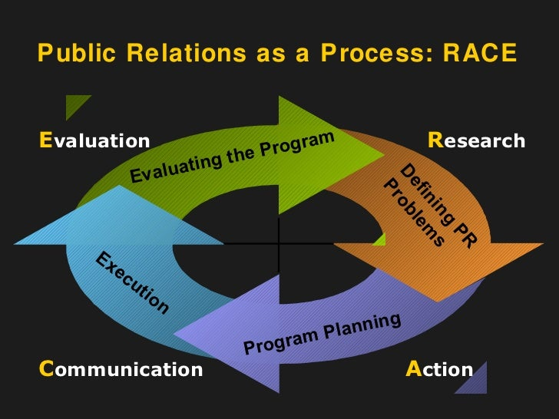
Online PR
How does Online-PR work?

Slide 62
Online PR & Reputation Management
Public relations (PR) can help raise your business’ profile and improve your reputation. If done well, it can be a cost-effective way to get your message to a large audience.
Online Public Relations (E-PR, Digital PR) functions the web relationship influence among the cyber citizens and it aims to make desirable comments about an organization.
Compared with traditional public relations channels (such as TV, radio and printed press), the network systems used for online public relations vary from search to social platforms.
https://www.youtube.com/watch?v=IZixqBZ8HoY
https://www.youtube.com/watch?v=p1in8uuAu7g

Slide 63
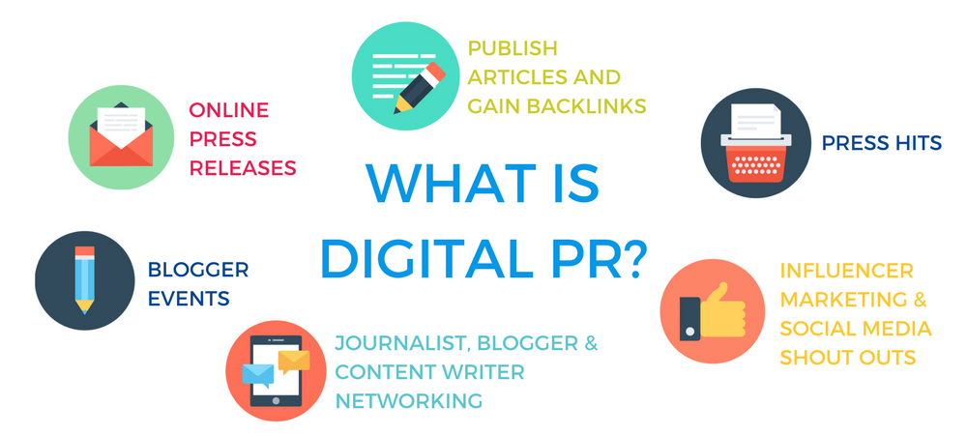
Key Techniques of Online PR

Slide 64
Public Relation
Benefits of public relations (PR)
Influence
Reach
Cost-effectiveness
Challenges of public relations (P.R)
No direct control
No guaranteed results
Evaluation

Slide 65
Online Reputation Management
Your online reputation is how others see you when they look for you online.
Google yourself. What do you see?
Are you represented fairly?
Everyone has an online reputation.
Online reputation management (ORM) means taking control of the online conversation. Its techniques and strategies ensure that people find the right materials when they look for you on the Internet.
The purpose of online reputation management is to create balance, counteract misleading trends, and allow you to put your best foot forward.

Slide 66
Online Reputation Management
Online reputation management (ORM) is the practice of crafting strategies that shape or influence the public perception of an organization, individual or other entity on the Internet. It helps drive public opinion about a business and its products and services.
Reputation handlers can build extensive website projects to distribute text, video or other elements, or use social media analytics to determine a company’s status before engaging in products that influence reputation on a social media platform like Facebook or Twitter.

Slide 67
Online Reputation Management
Online reputation management (ORM) is when, in order to address any negative or false comments, you actively monitor mentions of your brand on websites and social media.
ORM mainly works by responding to negative customer comments online and reacting to stories in the media (both social and traditional) that paint your company in a bad light.
For example, you might release a public statement addressing the content of the story or publish a social media post in response.

Slide 68
Online Reputation Management
The hits a brand takes online can be numerous, but they’re often small attacks—a negative comment here, a low star rating there.
None of these blows is worth a full-scale PR campaign, but they add up quickly.
You need online reputation management to take care of each of these little fires before they amount to serious damage.
ORM is also important for maintaining transparency—a vital ingredient of brand loyalty in 2020.
With online reputation management, your business combats negative claims by addressing them directly and openly.

Slide 69
Online Reputation Management
Two cycles of online reputation
Vicious Cycle: Ignore your online reputation and you risk falling victim to a vicious cycle of misinformation and rumors.
Virtuous Cycle: Take care of your online reputation and you create a virtuous cycle of positive, quality materials that reflect well on you.
https://www.reputationdefender.com/what-online-reputation-management

Slide 70
Online Reputation Management
5 Online Reputation Management Strategies You Can Use:
1. Answer Promptly and With Empathy.
2. Address Negativity Up Front.
3. Own Up To Your Mistakes
4. Stay on Top of Your Search Results
5. Automate Online Reputation Management.

Slide 71
Online Reputation Management
How ORM is different from PR
PR firms work externally, such as through advertising and coordinated media promotional efforts. It’s mostly a proactive effort to strengthen brands instead of minimizing attacks on companies (though PR firms do sometimes handle damage control).
Online reputation management, on the other hand, is most often reactive. It involves looking for and responding to potentially damaging content from other people or companies.
Most of the work that goes into ORM is handled internally by brands rather than by an external firm.

Slide 72
Online Reputation Management Case Study
Case Study: United Airlines
One company that understands this better than most is United Airlines, which is still trying to find its footing after being deemed “evil” on social media. In 2017, video of United Airlines security personnel violently dragging a passenger off of an overbooked flight went viral, generating over 1 million mentions a day on Facebook, Instagram, and Twitter in the immediate aftermath. This social media storm ignited national outrage and caused United’s stock to quickly lose more than $1 billion in market value. While the stock has since recovered, the company’s reputation remains tarnished and continues to serve as fodder for late-night comedians.

Slide 73
Recap
In this topic ,we learned about Online Public Relations
We have also learned about how Online PR is different from PR & Online Reputation Management.

Slide 74
Daily Quiz
Online PR is ______.
State the relevance of Reputation management in Digital Marketing.
__________ is the practice of crafting strategies that shape or influence the public perception of an organization, individual or other entity on the Internet.
State any 2 key characteristics of Online PR.

Slide 75
Noida Institute of Engineering & Technology, Greater Noida
ROI of Digital Strategies
Topic 4
Digital Marketing (AOE0667)

Slide 76
Topic Objective/ Topic Outcome
Name of Topic | Objective of Topic | Mapping with CO
ROI of Digital Strategies | To study the ROI of Digital Strategies & evaluating Cost Effectiveness of Digital Strategies | CO4

Slide 77
ROI of Digital Strategies
Return on investment (ROI) is an important part of digital marketing (and really, almost every part of marketing)—it tells you whether you're getting your money's worth from your marketing campaigns.
Marketing ROI is the practice of attributing profit and revenue growth to the impact of marketing initiatives.
By calculating return on marketing investment, organizations can measure the degree to which marketing efforts contribute to revenue growth. Typically, marketing ROI is used to justify marketing spend and budget allocation for ongoing and future campaigns and initiatives.
https://www.youtube.com/watch?v=cT42N8scarQ

Slide 78
ROI of Digital Strategies
To understand what the ROI is, we need to understand what the goals or aims of the company are, what they wish to get from a digital marketing campaign and then measure these goals. For this we need to look at the Key Performance Indicators (KPIs) and the goals for each one.
Your digital marketing’s ROI is a measurement of your online marketing campaign’s profits or losses, which you calculate with the following formula: (net profit / total digital marketing costs) x 100.

Slide 79
ROI of Digital Strategies
Measuring your online marketing ROI helps you determine the effectiveness of your strategies.
The fundamental formula for calculating your digital marketing ROI is:
ROI = (Gains from investment - cost of investment)/(cost of investment) × 100%

Slide 80
ROI of Digital Strategies
Here are some types of key performance indicators:
General Performance – Traffic, leads, Reach.
Channel Based – Website, blog, social networks, search engines.
Source based performance – Direct traffic, Organic search, referrals, email, PPC.
Campaign based performance – Lead generation, click through, conversions, conversion rates.
Setting realistic and measurable goals.

Slide 81
Tools for measuring ROI
1. Google Analytics: Content ROI
If you run a website, Google Analytics is simply a must-have tool. It helps you to track every source of traffic to your website pages. Some important metrics you get from your Google Analytics dashboard are:
Page views
Bounce rates
Visitors location
Source of traffic
https://www.youtube.com/watch?v=mreOWm3e9lg
2. Cyfe
This is another tool that helps you to prove your digital marketing ROI across various marketing channels: Advertising, Blogging, Email, Sales & Finance, SEO and Social media

Slide 82
Tools for measuring ROI
Social media marketing ROI
3. Hootsuite
In most cases, a business will maintain a presence in many social media platforms. It can be tedious to track your results on these social media channels individually.
4. Sproutsocial
You can measure your social media metrics on this platform as well. Apart from creating goals on Google Analytics, you need to have the knowledge of your performance.

Slide 83
Tools for measuring ROI
Search Engine Marketing RPO
Gaining organic traffic from search engines to your website is crucial. Because it’s a targeted source of traffic with people searching keywords related to your service, this will certainly boost your digital marketing results.
5. SEMrush
Apart from being one of the most popular keyword research tools today, you can also use SEMrush to get insights from your organic traffic. With its Organic Traffic Insights tool, you can get details about the number of users who visit your website through search engines.
6. Sleeknote
When you have the basic numbers about your email performance and your investment value, Sleeknote can help you calculate important email results and your digital marketing ROI.

Slide 84
Evaluating Cost Effectiveness of Digital Strategies
Measuring against goals
The first step to understanding the cost effectiveness ratio of your digital marketing. If you’re paying a blogger to share a product testimonial and you only get 6 new followers from their efforts – that might seem like an expensive campaign metric
If your goal was more followers, but it might be a more valuable investment – new fans – than simply generating clicks which are a lower form of engagement.
Measuring cost-effectiveness will always depend on your goals and your results.

Slide 85
Evaluating Cost Effectiveness of Digital Strategies
Understanding not all cost is monetary
While most people performing a cost-effectiveness analysis of their digital marketing efforts might simply try to understand campaign bottom-line dollars spent per impression, other businesses understand that the time it takes to brainstorm campaign concepts, create content, design digital advertising all have an inherent “cost” in the form of time or salary.
The cost of marketing is beyond the money paid to a publisher to promote a piece or host an ad – don’t forget to factor in the “hidden” costs of creating digital marketing content.
.

Slide 86
Evaluating Cost Effectiveness of Digital Strategies
Use a cost-benefit analysis template
Whether it’s an old-fashioned worksheet or a high-end software, strategizing the cost-benefit of a project before it’s ever launched can help you strategize the most cost-effective concepts to begin with.
Using a cost-benefit analysis spreadsheet or software helps you understand the strengths, weaknesses, and alternatives for your idea, which makes it easier to calculate the risks and possible ROI.

Slide 87
Daily Quiz
1. ROI stands for ________.
The fundamental formula to calculate ROI is _______.
_____ is a tool to measure Content ROI.
Hoot suite is a tool to measure ROI of Social media. (True/ False)
Cyfe is a tool to measure ______ ROI.

Slide 88
YouTube & NPTEL Video Links along with Online Course Details
https://www.youtube.com/watch?v=508CR1fd8ws
https://www.youtube.com/watch?v=YWA-xbsJrVg
https://www.youtube.com/watch?v=yD24fofvvVg
https://www.coursera.org/courses?query=digital%20transformation
https://www.coursera.org/search?query=website%20development&

Slide 89
MCQs
The correct abbreviation of ROI is __________.
Risk on Investment
Return on Investment
Risk on Income
Return on Income
2. __________ falls under the A/B testing tools.
Google Content experimentation
Visual Website Optimization
Both of these
None of these
3. Digital business Infrastructure refers to the combination of ________
Hardware
Software
Servers
All of these

Slide 90
MCQs
4. IoT stands for ____.
Information Of Things
Input Output Things
Internet of Technology
Internet of Things
5. The transformation of key business processes through the use of digital or Internet technologies is known as ____________
E business
E commerce
Digital business
Both a and c

Slide 91
Glossary Question
i) IoT ii) digital leader iii) Digitalization iv) hierarchical
1. _______ is the adoption of digital technology to transform services or businesses by replacing manual processes with digital processes.
2. The term _______ is used for devices that wouldn't usually be generally expected to have an internet connection.
3. The _______ could be a company that has successfully taken advantage of their digital assets to gain and maintain a competitive edge.
4. The most common website structure is a ________ one that is based on one parent page and child pages.

Slide 92
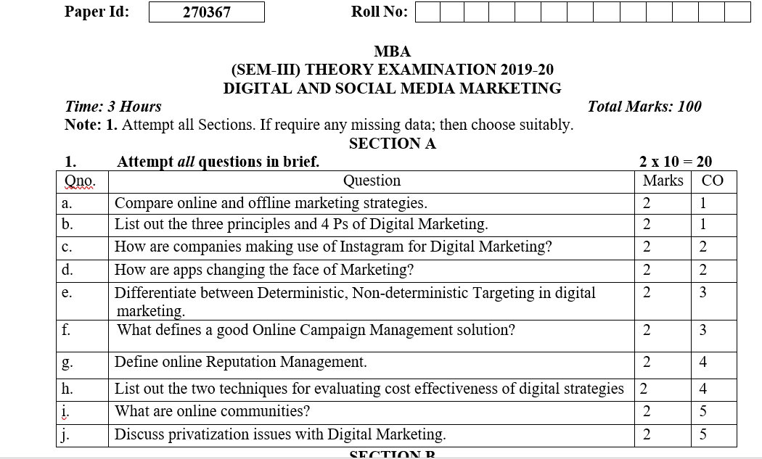
Old Question Papers

Slide 93
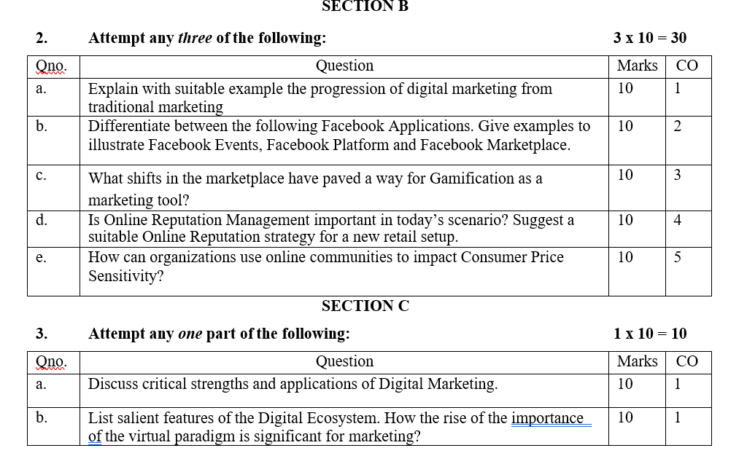
Old Question Papers

Slide 94
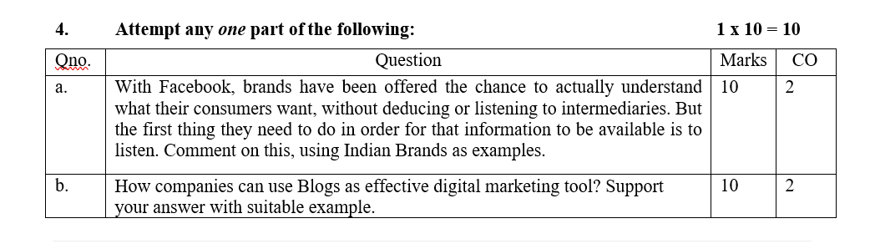
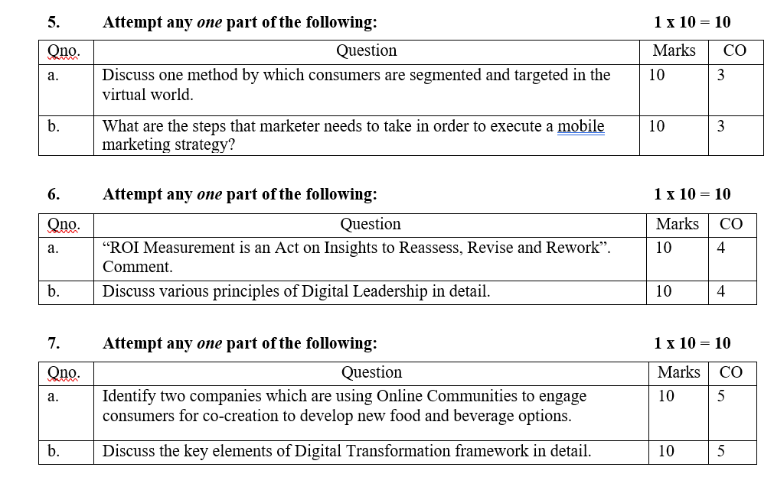
Old Question Papers

Slide 95
Expected Question for University Exam
Define the term 'digital organization’.
Discuss what does DT refer to?
Define what is Cloud computing?
Explain how does Online PR work?
Explain what does website structure refer to?
Explain how is Online PR different from traditional PR?
Discuss the methods for calculating Social media marketing ROI.
Discuss what does the term 'SMACIT' imply in terms of technology?

Slide 96
Links for University Question Paper
https://www.uptunotes.com/aktu-paper-digital-marketing-mammk04-2018-19/
http://www.aktuonline.com/papers/mba-3-sem-digital-and-social-media-marketing-kmbmk03-2020.pdf
http://www.aktuonline.com/papers/mba-3-sem-digital-marketing-rmbmk03-2020.html
http://www.aktuonline.com/papers/mba-3-sem-digital-marketing-rmbmk-03-2018-19.html

Slide 97
Recap of Unit
This unit tells us about the different functions of management like planning,staffing,organizing ,controlling and Directing.
This unit discusses about the characteristics, importance and principles of functions of management.

Slide 98
References
https://www.commonplaces.com/blog/the-importance-of-website-planning
https://www.spiralytics.com/blog/what-are-dynamic-websites/
Moutsy Maiti: Internet Mareting, Oxford University Press India
andana, Ahuja; Digital Marketing, Oxford University Press India (November, 2015).
Eric Greenberg, and Kates, Alexander; Strategic Digital Marketing: Top Digital Experts Share the Formula for Tangible Returns on Your Marketing Investment; McGraw-Hill Professional (October, 2013).
Ryan, Damian; Understanding Digital Marketing: marketing strategies for engaging the digital generation; Kogan Page (3rd Edition, 2014).

Slide 99
Thank You

